Slide 1
Procedural Map Generation Techniques
Presented by Herbert Wolverson Roguelike Celebration 2020

Slide 2
Who is Herbert Wolverson?
Author of the “Rust Roguelike Tutorial”
Author of upcoming titles: Learn Rust by Making Games and Rust Brain Teasers published by The Pragmatic Bookshelf.
Author of Nox Futura and far too many words on r/roguelikedev

Slide 3
Introduction
What is Procedural Generation?
How does it fit in with hand-made content?
History of Procedural Generation (more slides)

Slide 4
PART 1 – Basic Generation Techniques

Slide 5
Simple Room-Based Generation
You’ve probably seen this in Roguelike development tutorials.
Simple algorithm:
Start with a solid map.
Randomly select a room area.
If the room is solid, carve it out and store it in the “rooms” list.
Repeat until you have enough rooms.
Iterate your rooms list, and add dog-leg corridors.

Slide 6
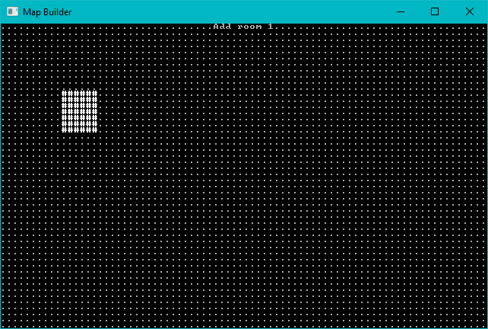
Start with a solid map, add one room at random.

Slide 7
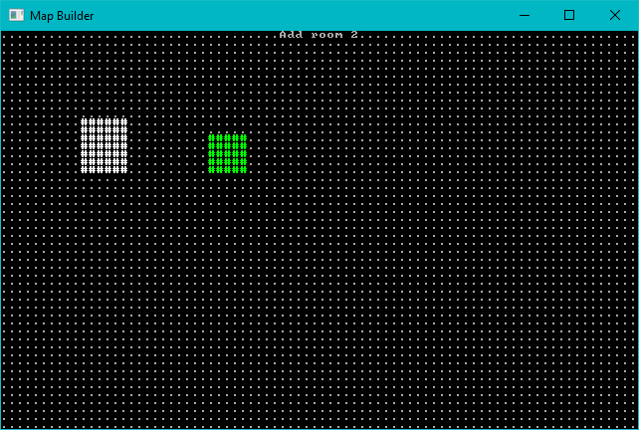
Add a second room

Slide 8
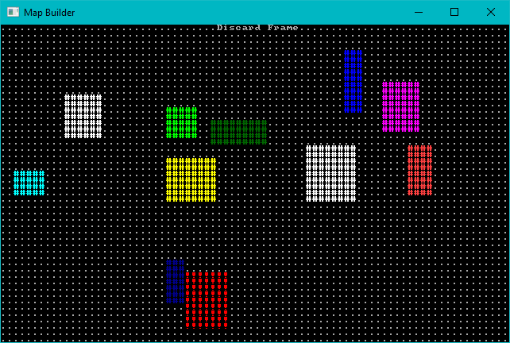
Keep Adding Rooms – Don’t Add Overlapping Ones

Slide 9
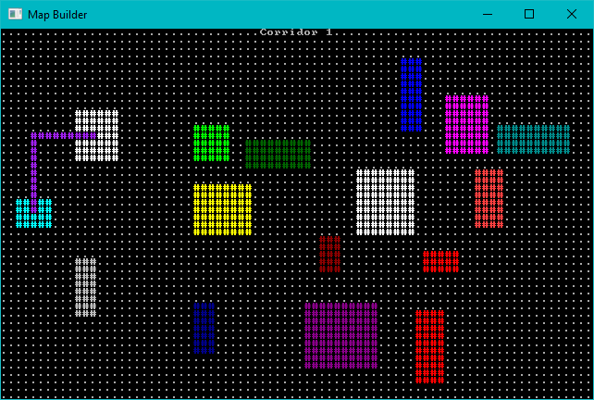
Add Corridors – Dog-leg Style

Slide 10
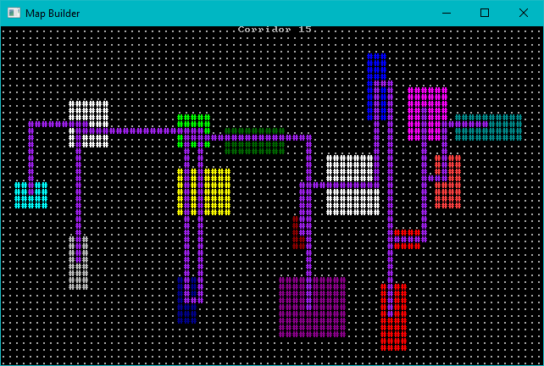
Add More Corridors Until Every Room is Connected

Slide 11
Room Algorithm - Animated

Slide 12
BSP Room-Based Generation
Nicer room generation. Nethack uses it.
Divide your map into squares – and divide those squares into squares.
Each sub-square might become a room.
Sort rooms and add corridors.

Slide 13
Step-by-Step Rooms

Slide 14
Using BSP for Interior Decorating
You can also use BSP for interior decorating.
Divide a square into squares, apply interior walls.
Not a great idea for a large map.

Slide 15
Step-by-Step Room Filling

Slide 16
Cellular Automata

Slide 17
Conway’s Game of Life

Slide 18
Bringing Order from Chaos

Slide 19
Drunkard’s Walk

Slide 20
Drunkard’s Walk Step-by-Step

Slide 21
Diffusion Limited Aggregation

Slide 22
DLA Progression

Slide 23
Voronoi Hive Maps

Slide 24
PART 2 – Mix It Up a Bit

Slide 25
Symmetry

Slide 26
Brushes

Slide 27
Corridor Algorithms

Slide 28
Erosion

Slide 29
Doors

Slide 30
Waveform Collapse

Slide 31
PART 3 – Combining Effects

Slide 32
PART 5 – Prefabs/Vaults

Slide 33
Noise

Slide 34
Wrap-Up

Slide 35
Questions?

